Slide 1
Lecture 12 Clustering, K-Means and EM
EE-uy 4563/El-GY 9123: Introduction to machine learning
Prof. Sundeep rangan, Modified by Yao Wang

Slide 2
Outline
Motivating Example: Document clustering
K-means
K-means for document clustering
Latent semantic analysis (Review of PCA)
Bag of words representation

Slide 3

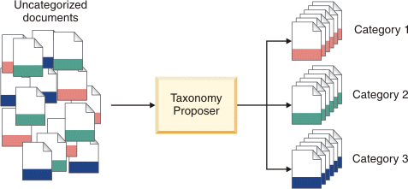
Document Clustering
Data mining
Often have huge numbers of documents
How can we organize this?
Key idea: documents are often in clusters
Can we detect these clusters?
Can be a lucrative service
See IBM service to left

Slide 4
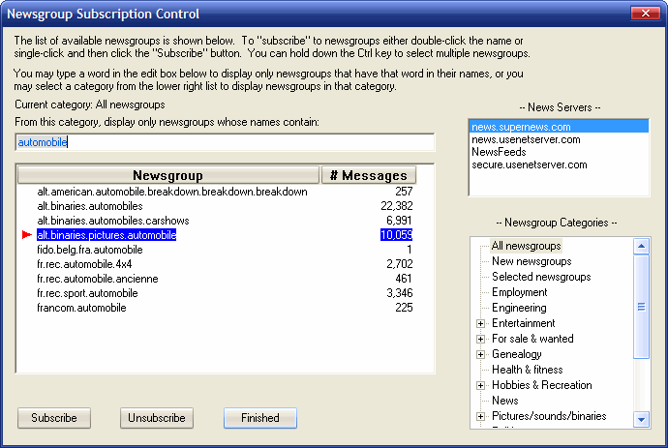
UseNet Newsgroups
Began in late 1970s
Discussion groups for various topics
Started on early university networks
Migrated to Internet
Peaked in 1990s
Useful for studying clustering
Simple documents
“ground truth”: Docs have categories

Slide 5
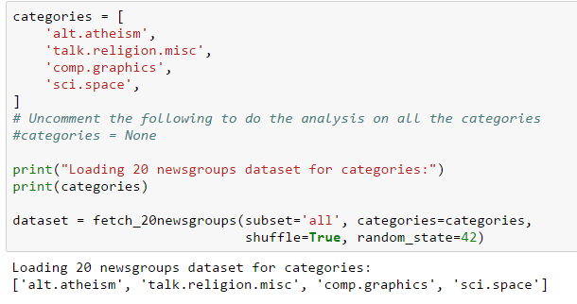
Loading the Data
See demo_doc_cluster.ipynb
Taken from http://scikit-learn.org/stable/auto_examples/text/document_clustering.html
Newsgroups built into sklearn

Slide 6
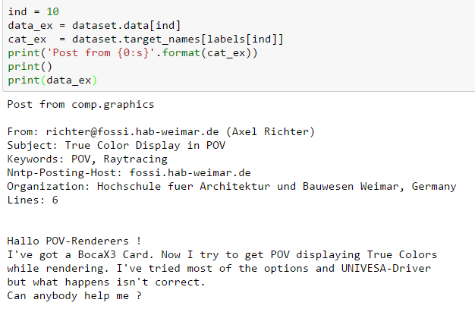
A Typical Newsgroup Post
Data for the posts are in:
Dataset.data
Dataset.labels
Dataset.target_names

Slide 7
Outline
Motivating Example: Document clustering
K-means
K-means for document clustering
Latent semantic analysis
Bag of words representation

Slide 8
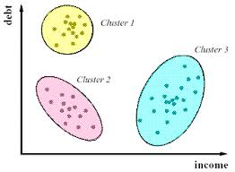
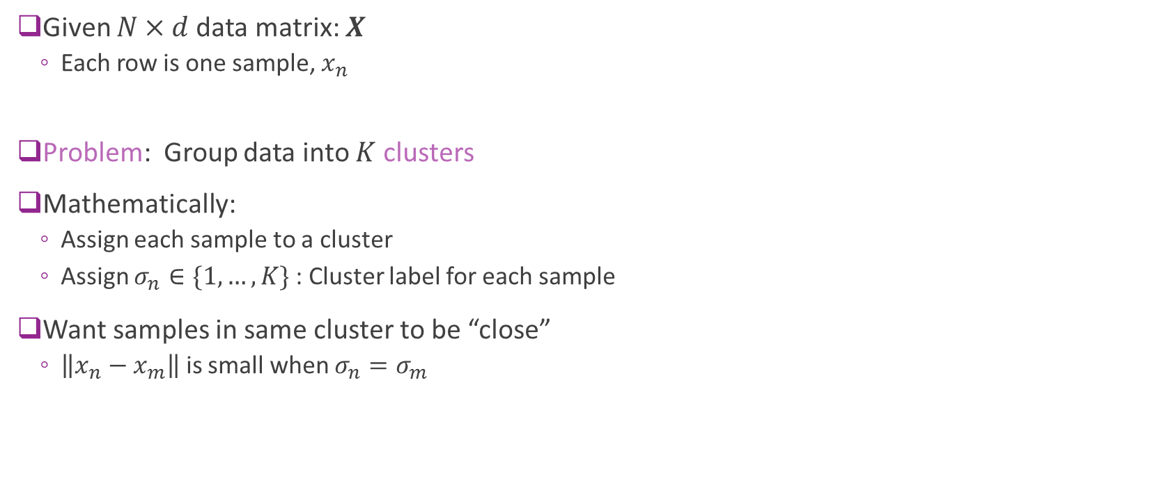
Clustering
Given $N×d$data matrix: $X$
Each row is one sample, $x_{n}$
Problem: Group data into $K$ clusters
Mathematically:
Assign each sample to a cluster
Assign $σ_{n}∈\{1,…, K\}$ : Cluster label for each sample
Want samples in same cluster to be “close”
$\left\|x_{n}−x_{m}\right\|$ is small when $σ_{n}=σ_{m}$

Slide 9
Clustering
Clustering has many applications
Any time you want to segment data
Uncovering latent discrete variables
Examples:
Segmenting sections of an image
Segmenting customers in market data
From: Market segmentation possibilities in the tourism market context of South Africa

Slide 10
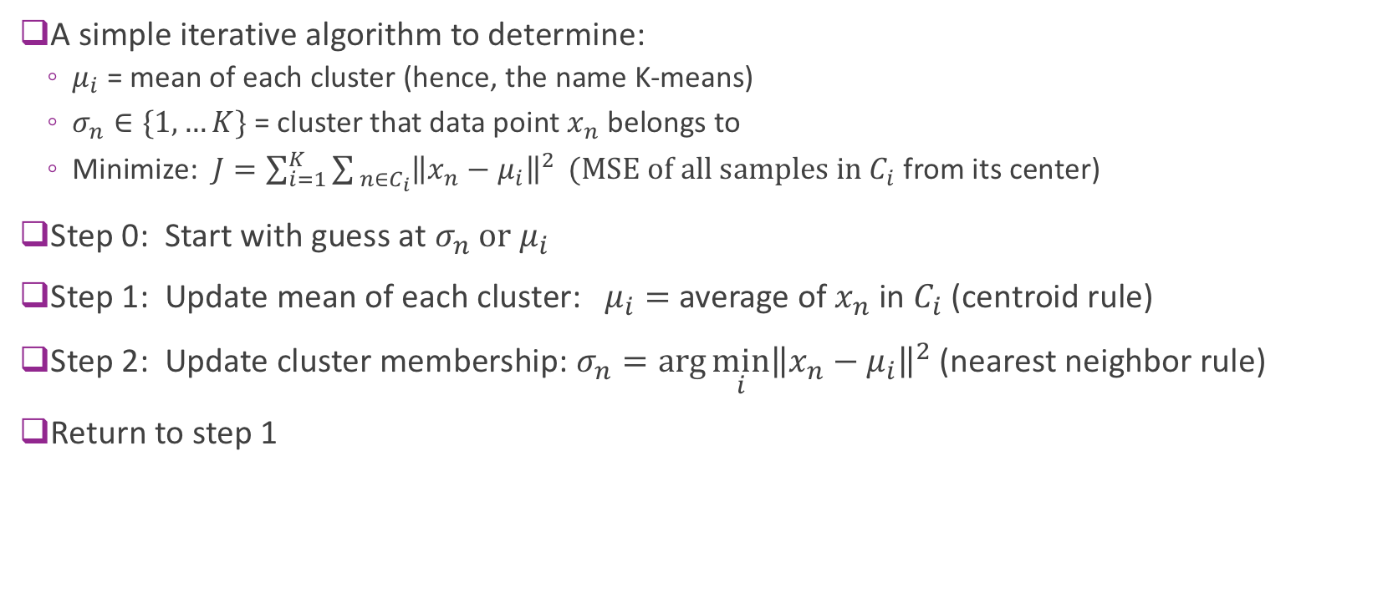
K-means
A simple iterative algorithm to determine:
$μ_{i}$ = mean of each cluster (hence, the name K-means)
$σ_{n}∈\{1,…K\}$ = cluster that data point $x_{n}$ belongs to
Minimize: $J=\sum_{i=1}^{K}{\sum_{ n∈C_{i}}{{\left\|x_{n}−μ_{i}\right\|}^{2}}} (MSE of all samples in C_{i}$ from its center)
Step 0: Start with guess at $σ_{n} or μ_{i}$
Step 1: Update mean of each cluster: $μ_{i}=$ average of $x_{n}$ in $C_{i}$ (centroid rule)
Step 2: Update cluster membership: $σ_{n}=\arg{\min_{i}{{\left\|x_{n}−μ_{i}\right\|}^{2}}}$ (nearest neighbor rule)
Return to step 1

Slide 11
K-Means illustrated
From Bishop, Chapter 9.
K-Means on “old faithful” data set

Slide 12
Image Segmentation Based on Color
Also from Bishop.
Use K-means on the RGB values (dimension = 3)
Notes:
Image segmentation usually uses clustering

Slide 13
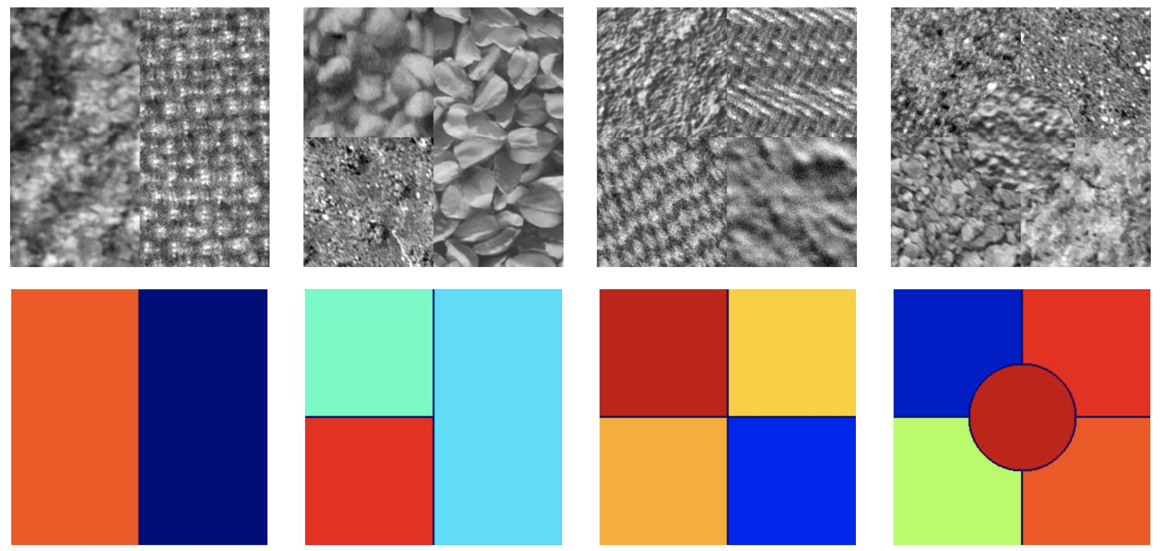
Image segmentation based on texture
Texture at each pixel is usually described by some statistics of the neighborhood surrounding the pixel.

Slide 14
Numerical Example

Slide 15
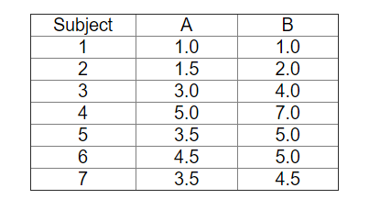
Consider the following dataset

Slide 16
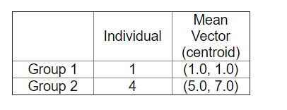
Grouped into 2 groups

Slide 17
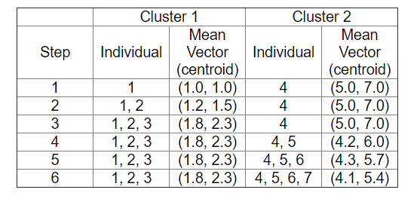
After one pass:

Slide 18
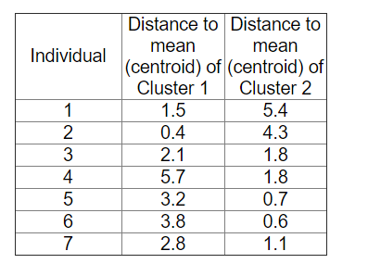
Compare distances. Problem?

Slide 19
Is there a problem?

Slide 20
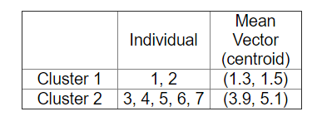
Final Clusters

Slide 21
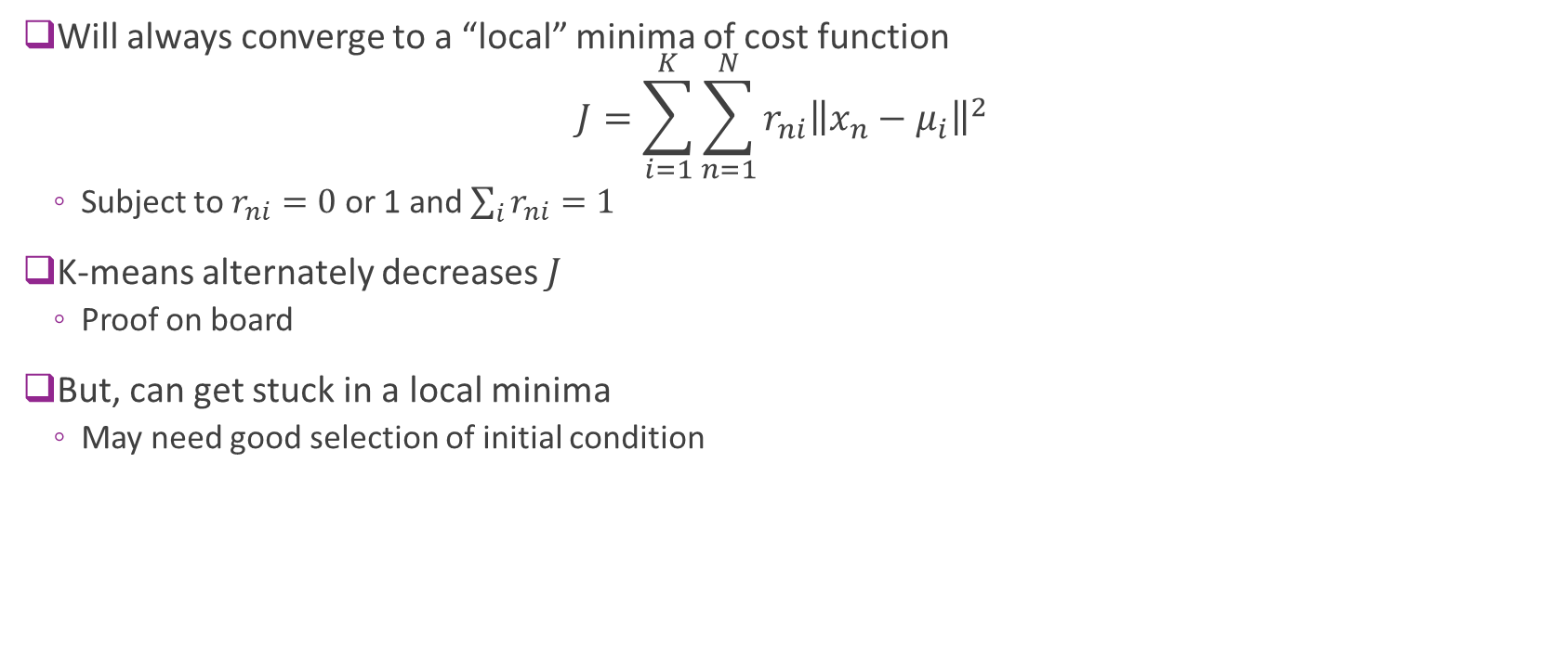
Convergence
Will always converge to a “local” minima of cost function $J=\sum_{i=1}^{K}{\sum_{n=1}^{N}{r_{ni}{\left\|x_{n}−μ_{i}\right\|}^{2}}}$
Subject to $r_{ni}=0$or 1 and $\sum_{i}{r_{ni}=1}$
K-means alternately decreases $J$
Proof on board
But, can get stuck in a local minima
May need good selection of initial condition

Slide 22
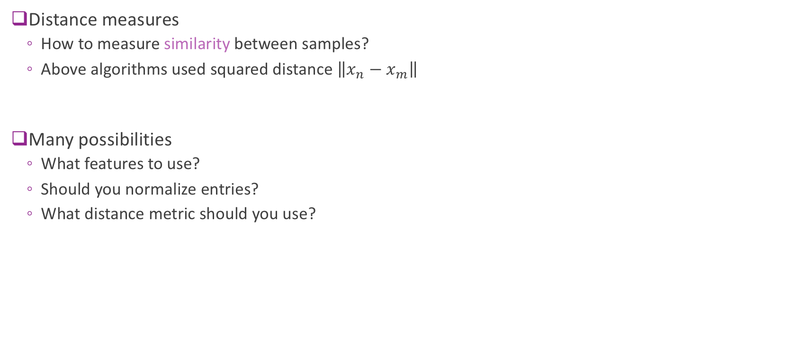
Distance measures
Distance measures
How to measure similarity between samples?
Above algorithms used squared distance $\left\|x_{n}−x_{m}\right\|$
Many possibilities
What features to use?
Should you normalize entries?
What distance metric should you use?
Notes:
L2 norm can be replaced with any norm

Slide 23
Initialization
Initialization:
Final limit of K-means depends on initial condition
May obtain poor clustering with bad initial condition
Possible solutions:
K-means++: http://ilpubs.stanford.edu:8090/778/1/2006-13.pdf
Provides good initial condition based on data
Multiple initial starts
Notes:
Non convex optimization.

Slide 24
Outline
Motivating Example: Document clustering
K-means
K-means for document clustering
Latent semantic analysis
Bag of words representation

Slide 25
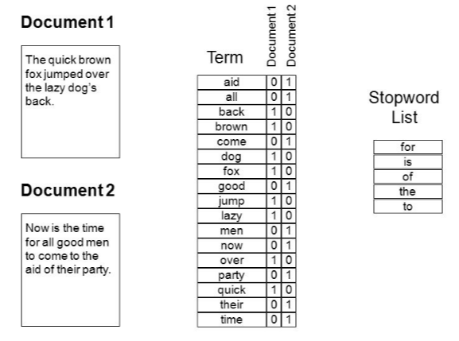
Bag of Words
Document is natively text
Must represent as a numeric vector
Represent by word counts
Enumerate all words
Each document is count of frequencies
Stopwords
Very common words
Not informative

Slide 26
Discussion Questions
Is the absolute number of times a word appears the correct metric?
What about the length of the document?
What about the frequency of the word?
What words “matter”?

Slide 27
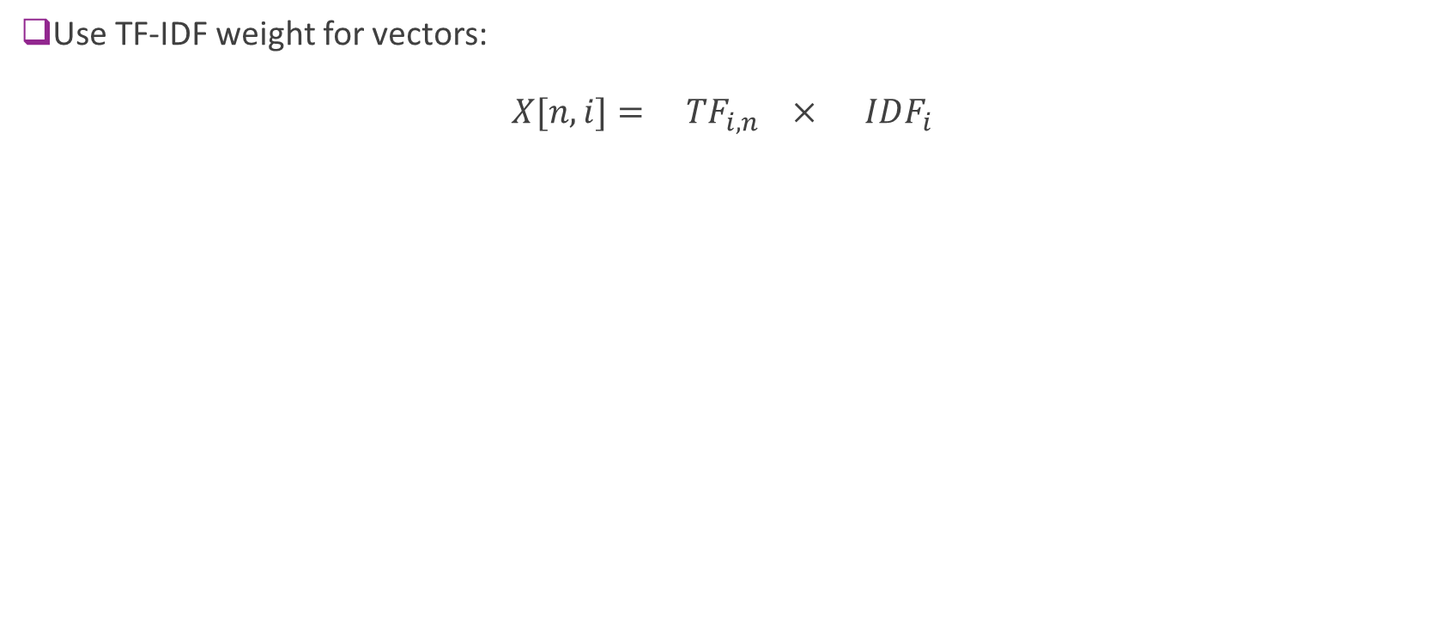
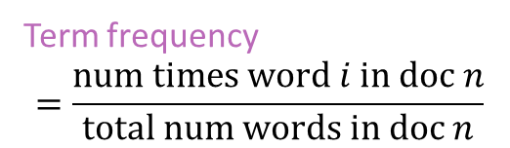
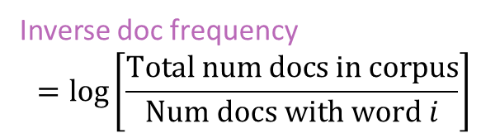
Term Frequency – Inverse Document Frequency
Use TF-IDF weight for vectors: $X[n,i]= TF_{i,n} × IDF_{i}$
Document weight vector
Term frequency
$$=\frac{\text{num} \text{times} \text{word} i \text{in} \text{doc} n}{\text{total} \text{num} \text{words} \text{in} \text{doc} n}$$
Inverse doc frequency
$$=\log\left[\frac{Total num docs in corpus}{Num docs with word i}\right]$$
Notes:
10 vs 1/10th

Slide 28
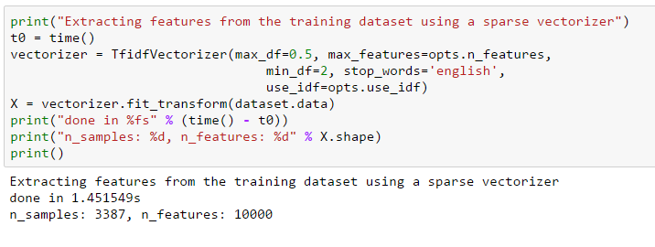
Computing TF-IDF in Python
Can compute the TF-IDF using sklearn functions
Notes:
Max-df = max doc frequency. Appears in more than half throw away.
Min_df = 2 appear at least twice

Slide 29
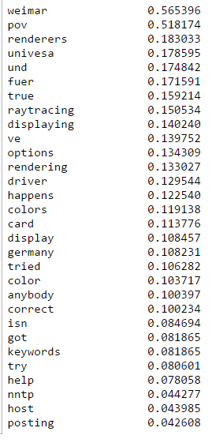
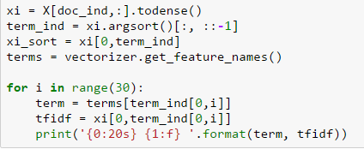
Typical TF-IDF scores
Code to display terms with highest scores

Slide 30
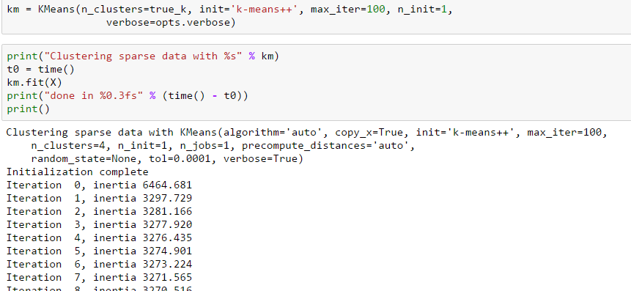
Running K-Means
Use Python built-in function

Slide 31
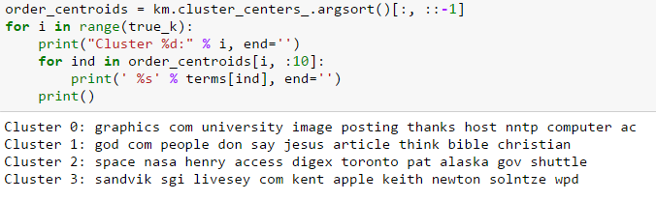
Plotting the Results
Most important words in each cluster
Highest weights in cluster centers
Notes:
Clusters were: religion, atheist, graphics, space

Slide 32
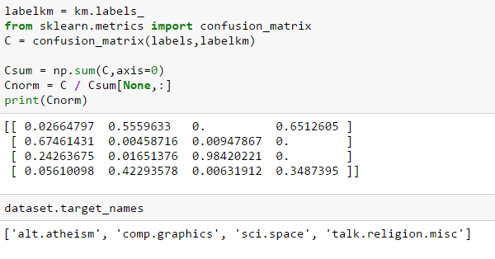
Confusion Matrix
Estimated clusters vs. true categories
Can you see where it got confused?

Slide 33
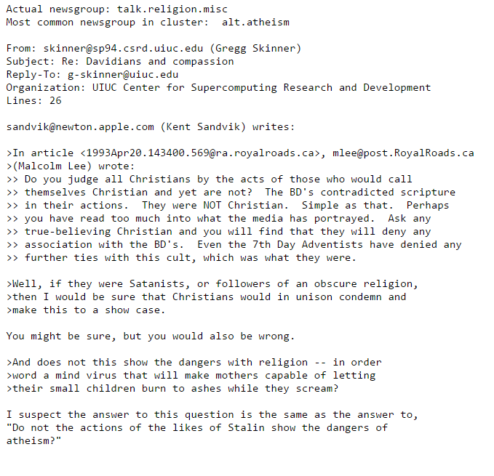
An Example “Wrong” cluster
Post is from talk.religion.misc
Placed in cluster with mostly alt.atheism

Slide 34
Outline
Motivating Example: Document clustering
K-means
K-means for document clustering
Latent semantic analysis
Bag of words representation

Slide 35
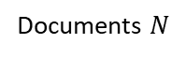
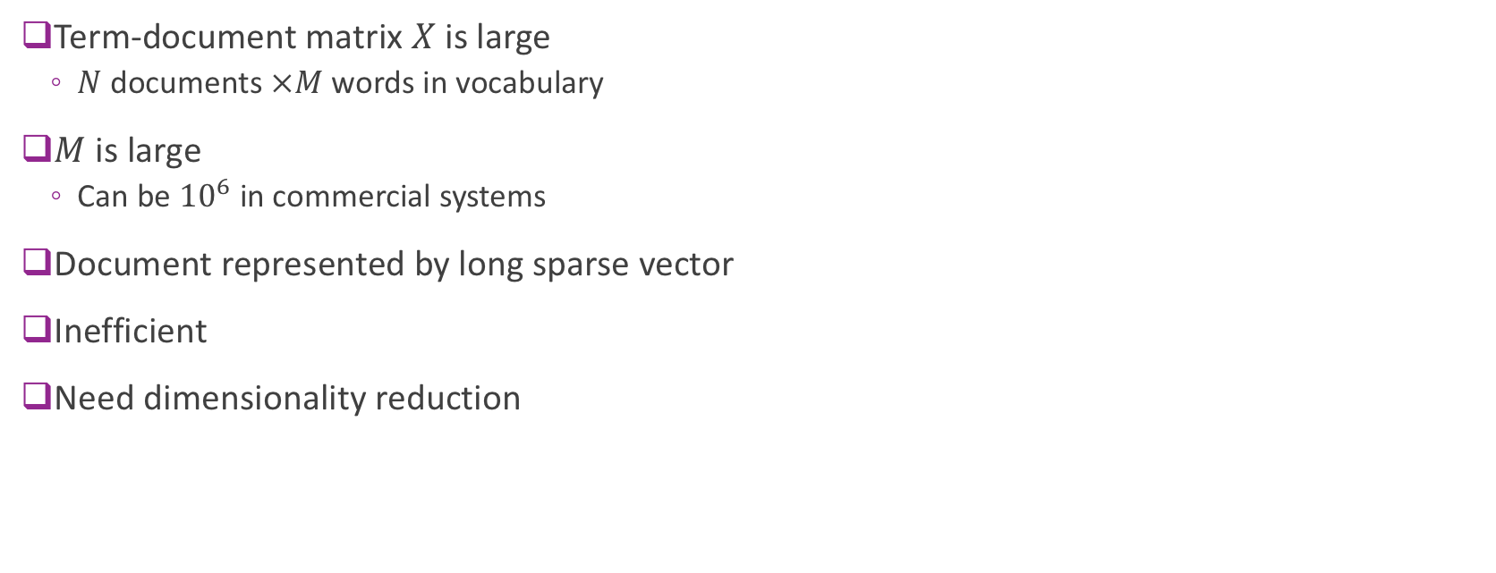
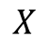
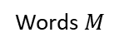
Need for Dimensionality Reduction
Term-document matrix $X$ is large
$N$documents $×M$ words in vocabulary
$M$ is large
Can be ${10}^{6}$ in commercial systems
Document represented by long sparse vector
Inefficient
Need dimensionality reduction
Words $M$
Documents $N$
$$X$$

Slide 36
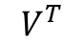
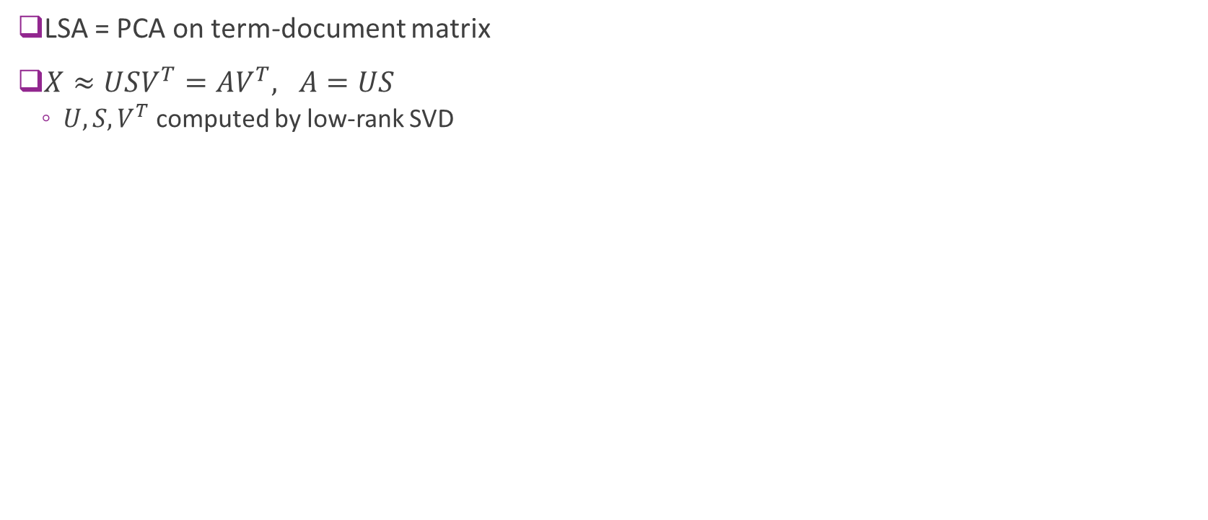
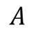
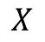
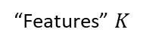
Latent Semantic Analysis (PCA revisited!)
LSA = PCA on term-document matrix
$X≈USV^{T}=AV^{T}, A=US$
$U,S,V^{T}$ computed by low-rank SVD
Words $M$
“Features” $K$
Words $M$
Words $M$
$$V^{T}$$
Documents $N$
=
$$A$$
$$X$$
Notes:
Tall by a fat matrix.

Slide 37
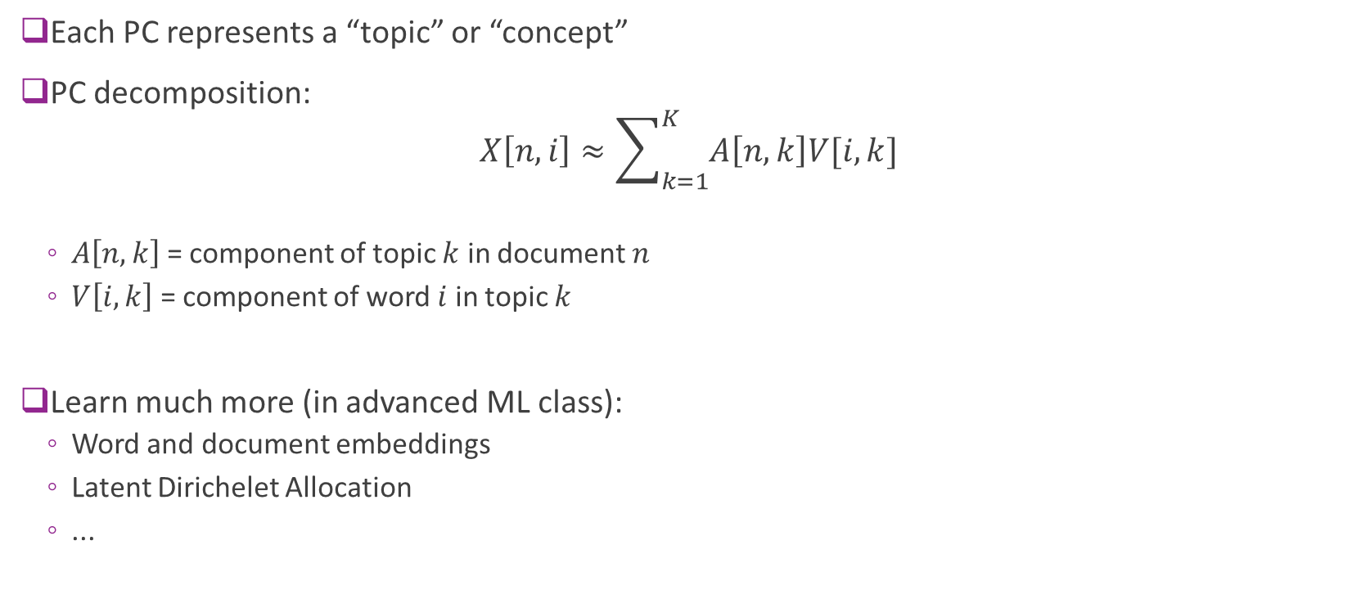
LSA Interpretation
Each PC represents a “topic” or “concept”
PC decomposition: $X\left[n,i\right]≈\sum_{k=1}^{K}{A\left[n,k\right]V[i,k]}$
$A\left[n,k\right]$ = component of topic $k$ in document $n$
$V\left[i,k\right]$ = component of word $i$ in topic $k$
Learn much more (in advanced ML class):
Word and document embeddings
Latent Dirichelet Allocation
...

Slide 38
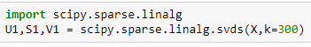
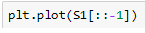
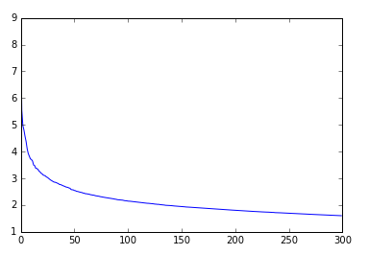
Perform LSA on NewsGroup
Use sparse SVD
Much faster
Concentration of variance in small number of PCs
More interesting results in larger corpi

Slide 39
Demo: color quantization using k-means

Slide 40
Other clustering methods
K-means and EM must know the number of clusters
To determine the ”optimal” number: Evaluate the cost function for different candidate numbers, on the validation set
Clustering methods that can determine the number of clusters automatically
Mean-shift (mode-seeking)
Dirichlet Process Mixture Model
Affinity propagation
…
What features to use?
Application dependent
PCA can be used for feature dimension reduction
Non-linear feature learning: Spectral clustering

Slide 41
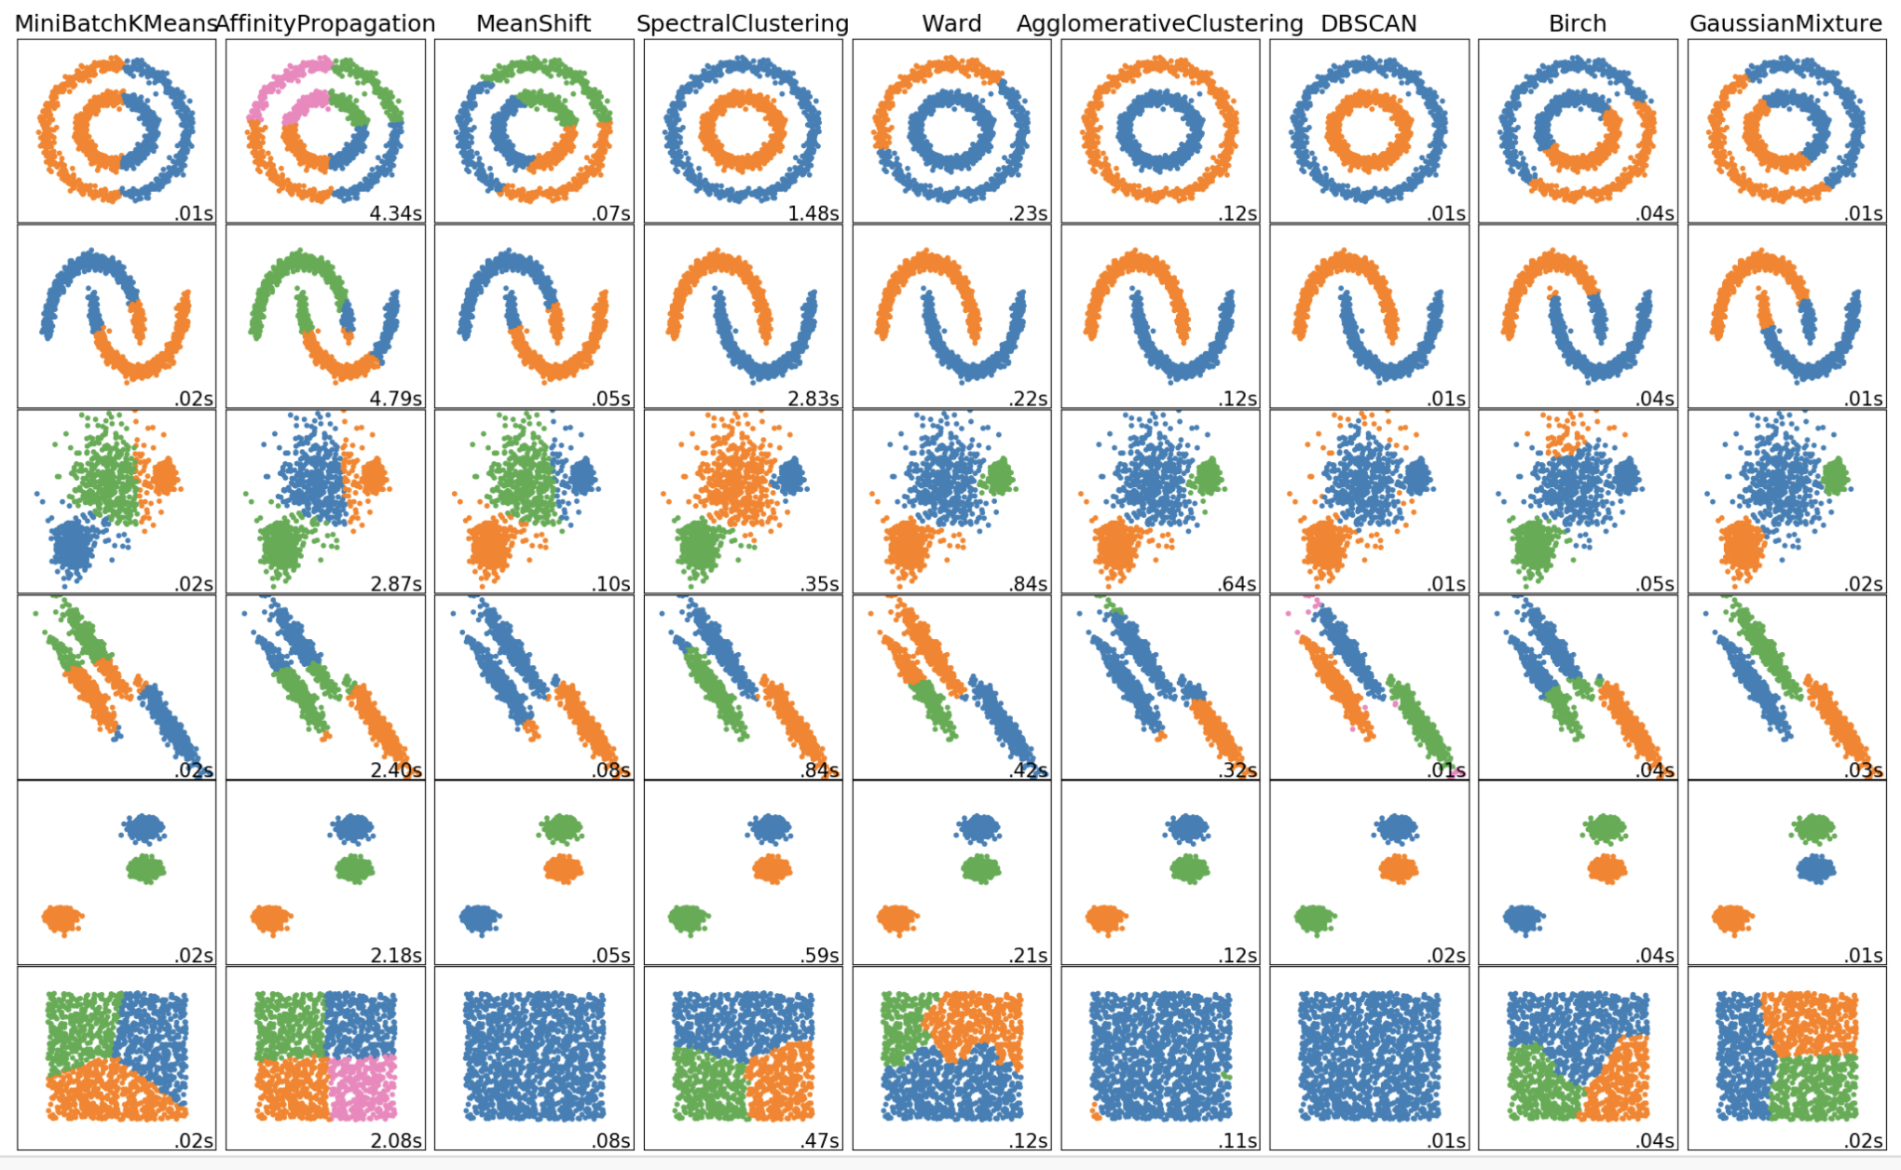
Examples in sklearn
http://scikit-learn.org/stable/auto_examples/cluster/plot_cluster_comparison.html#sphx-glr-auto-examples-cluster-plot-cluster-comparison-py

Slide 42
Deep learning for clustering (unsupervised learning)
DEEP EMBEDDED CLUSTERING (DEC)
Using an auto encoder to learn the latent features, which are then clustered by k-means
DEEP CLUSTERING NETWORK (DCN)
The network is trained using sum of the signal reconstruction error and the clustering loss after k-means
CLUSTERING CNN (CCNN)
Using Generative network
From: Clustering with Deep Learning: Taxonomy and New Methods, Elie Aljalbout, Vladimir Golkov, Yawar Siddiqui, Daniel Cremers, https://arxiv.org/pdf/1801.07648.pdf

Slide 43
Other applications of clustering
Image/signal compression
Each image block is “quantized” to one cluster pattern, and the entire block is described by the cluster index
Image segmentation
Each pixel is described by a color/texture descriptor and classified into one of the clusters
Image/signal classification through “Bad of Words” representation

Slide 44
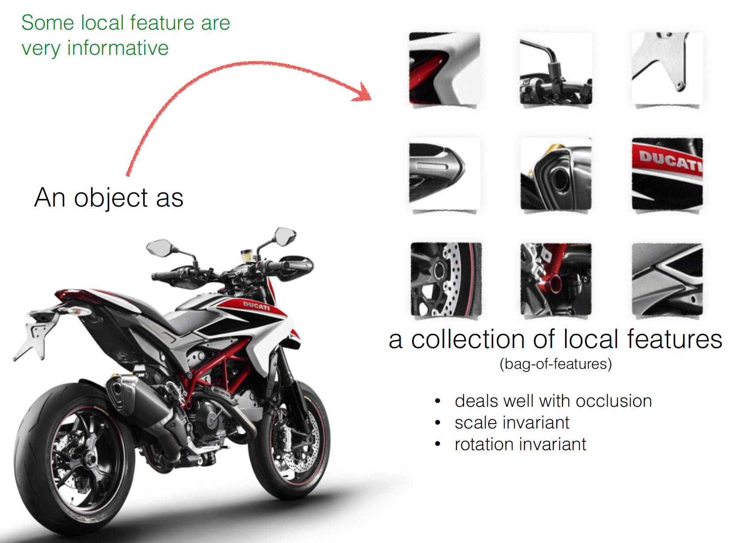
Bag of Visual Words for Image Classification
From http://www.cs.cmu.edu/~16385/lectures/Lecture12.pdf

Slide 45
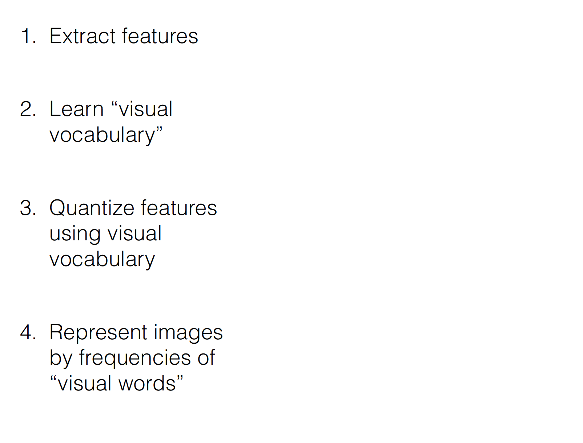
BoW Pipeline for Image Classification
From http://www.cs.cmu.edu/~16385/lectures/Lecture12.pdf

Slide 46
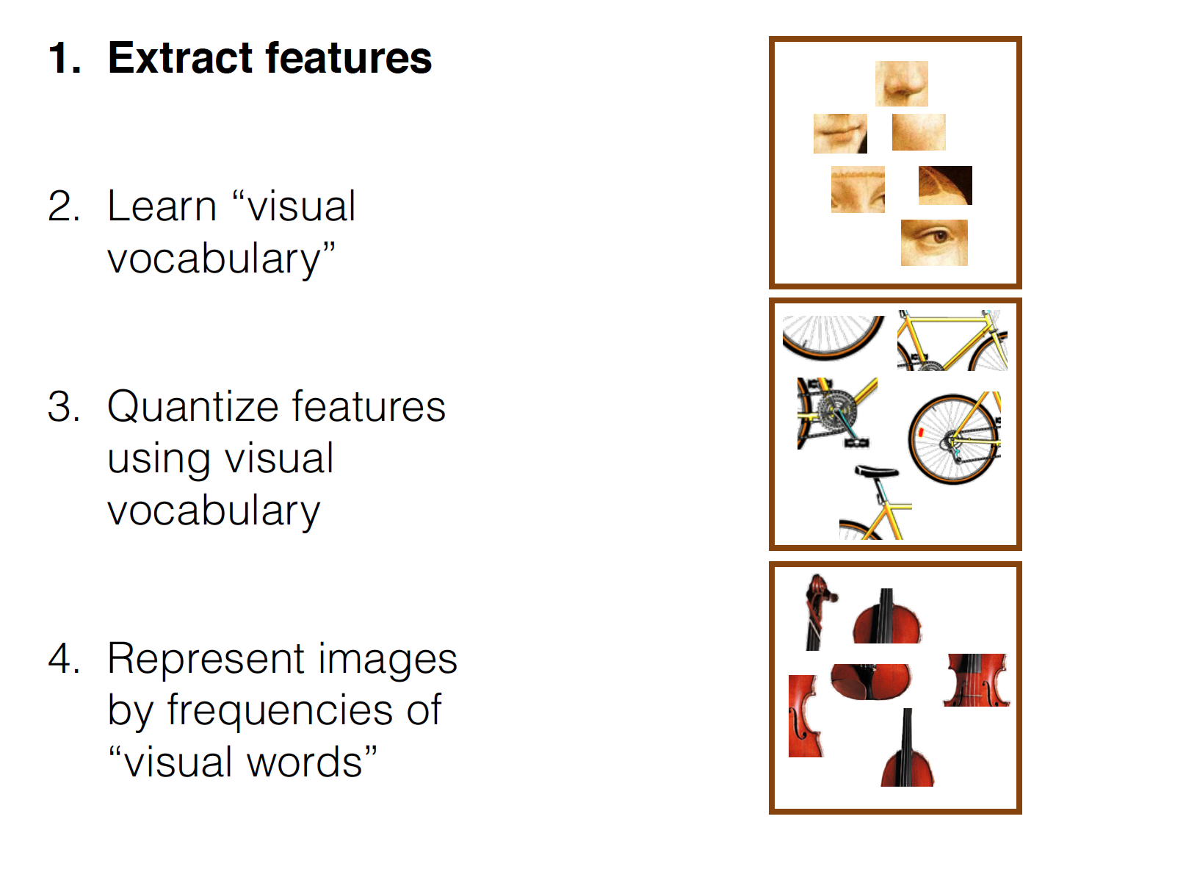
At every shifted patch or detect feature points
Use SIFT, HOG, or other descriptors
From http://www.cs.cmu.edu/~16385/lectures/Lecture12.pdf

Slide 47
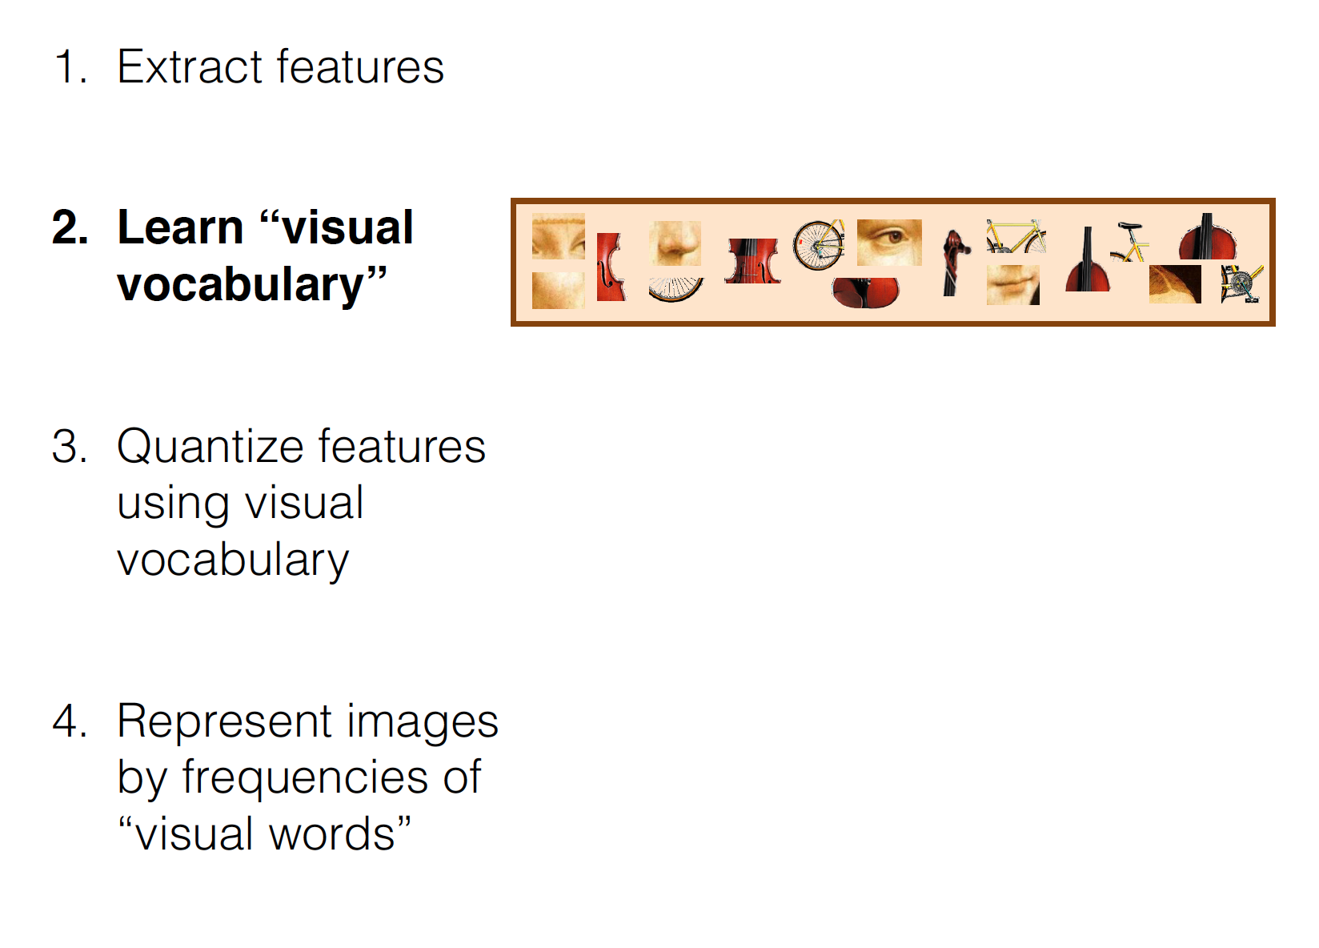
How to deduce these words ?
From http://www.cs.cmu.edu/~16385/lectures/Lecture12.pdf

Slide 48
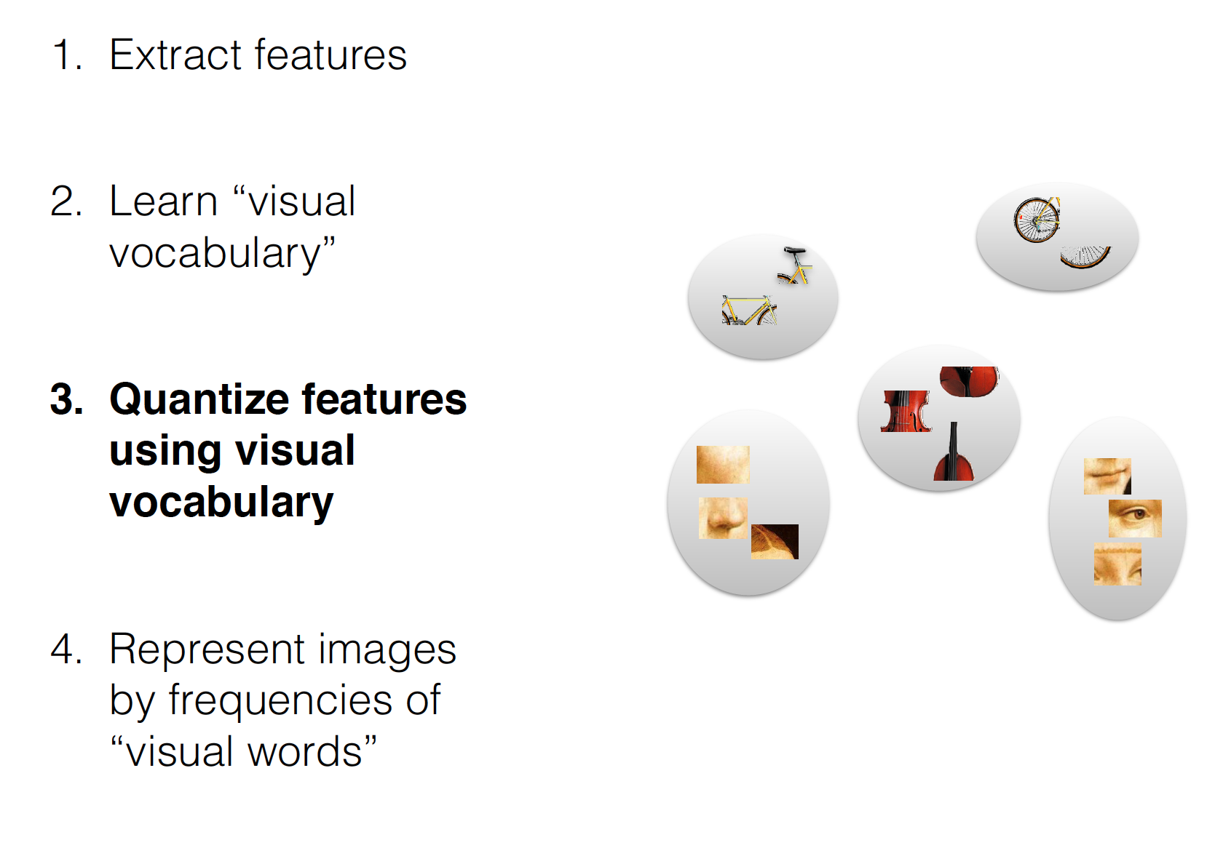
Find the dictionary atom that is closest to the original feature
(nearest neighbor search)
From http://www.cs.cmu.edu/~16385/lectures/Lecture12.pdf

Slide 49
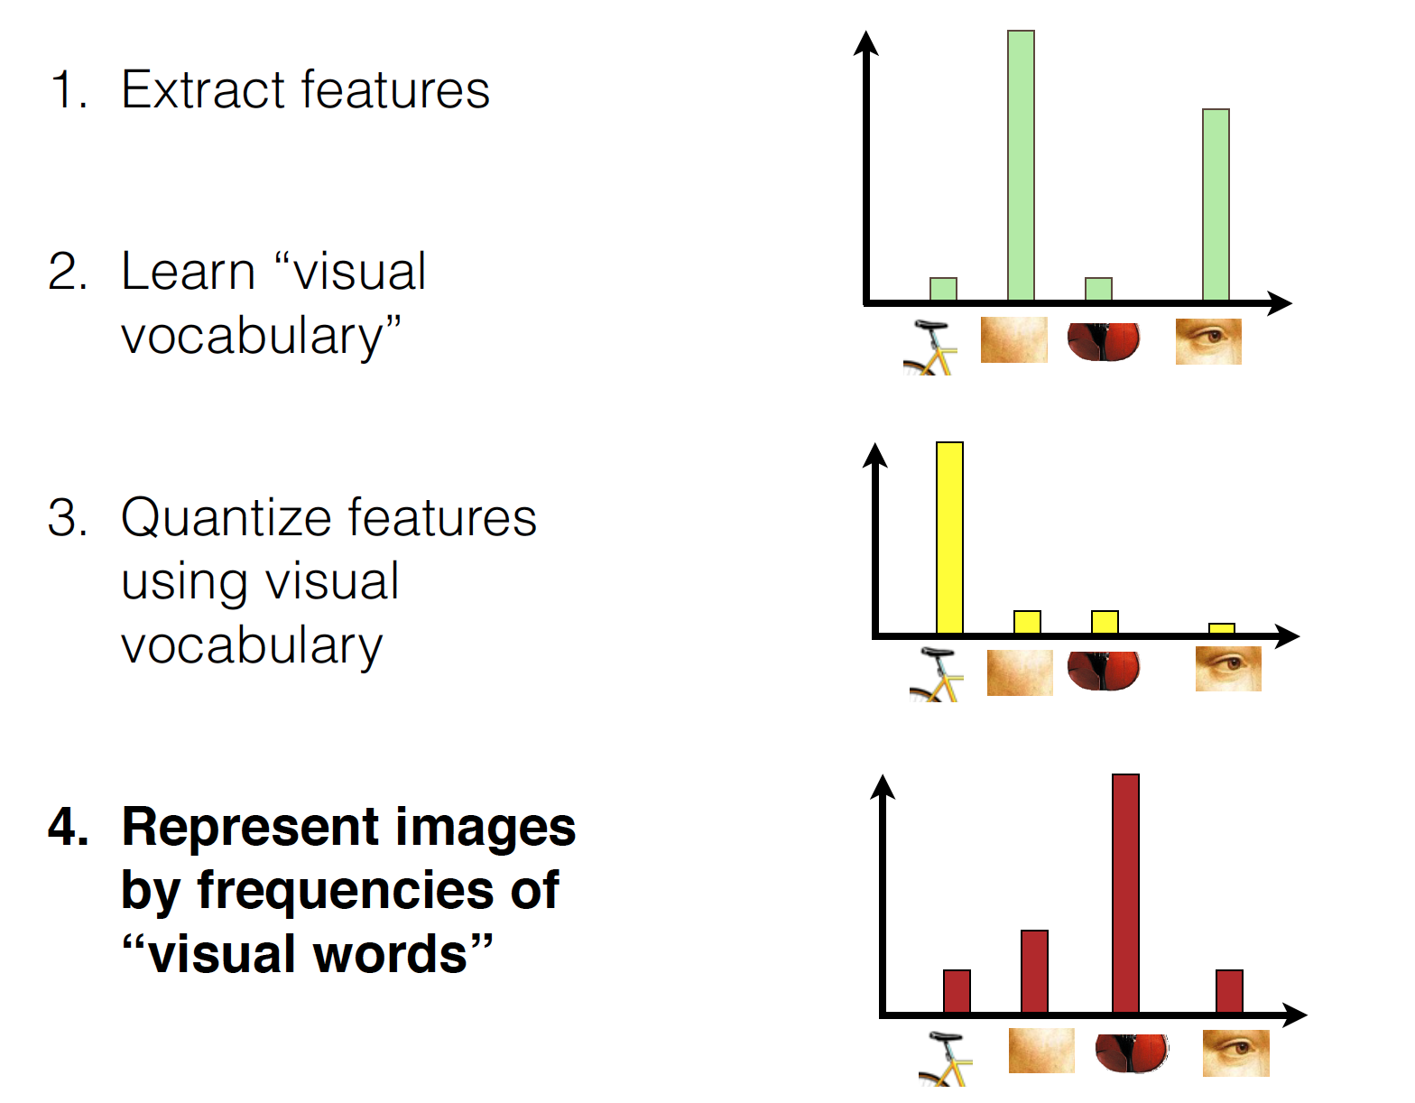
From http://www.cs.cmu.edu/~16385/lectures/Lecture12.pdf

Slide 50
How to Learn Visual Dictionary?
Assume you have feature vectors extracted from many training images
Apply K-means to all training feature vectors!
The training images should encompass categories to be classified
How to select initial centroids?
How to determine K?
Can you use EM instead?
Would EM be better?

Slide 51
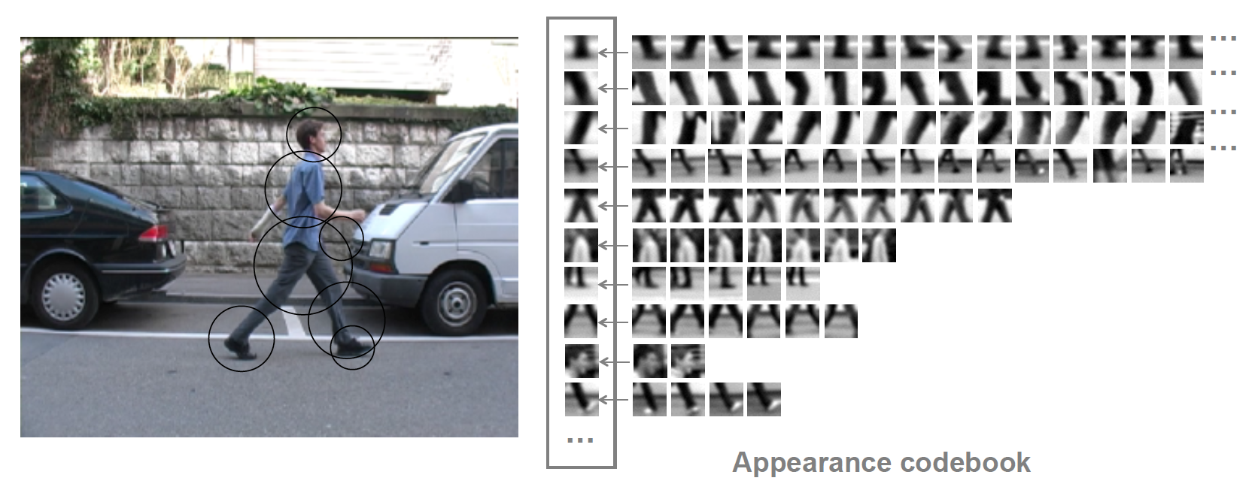
“words” from people
From http://www.cs.cmu.edu/~16385/lectures/Lecture12.pdf
From http://www.cs.cmu.edu/~16385/lectures/Lecture12.pdf

Slide 52
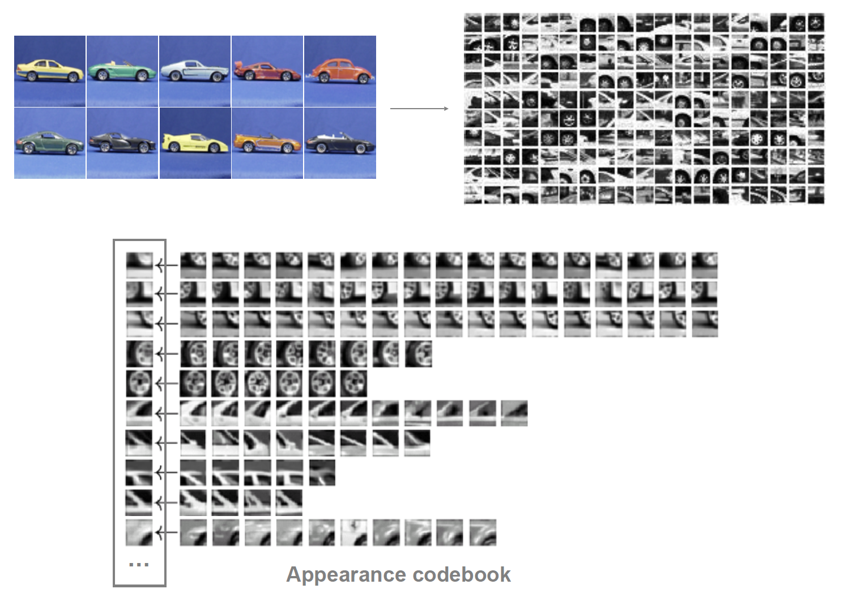
“Words” from cars
From http://www.cs.cmu.edu/~16385/lectures/Lecture12.pdf

Slide 53
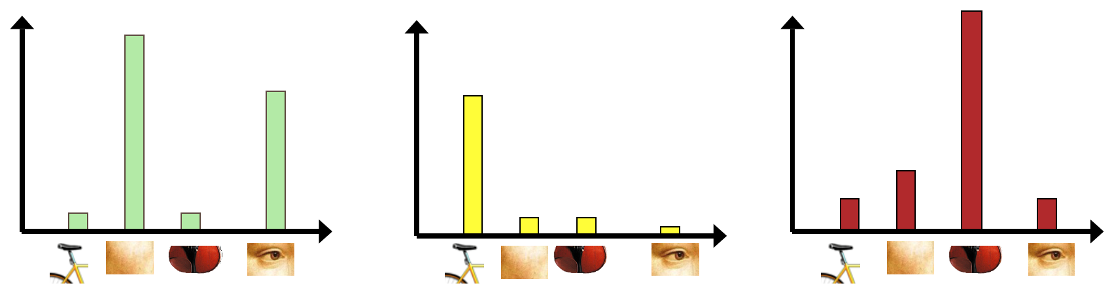
Histogram of Visual Words
Count how many times each “word” appears in an image -> Histogram of words
Can you tell the image types from the following histograms?
From http://www.cs.cmu.edu/~16385/lectures/Lecture12.pdf

Slide 54
How to Classify Images?
Use the histogram of words as the descriptor for an image
Train a classifier (e.g. Support Vector Machine) from training images
The most successful image classification method before deep learning ….

Slide 55
What you should know from this lecture
What is clustering?
Unsupervised!
K-means method
GMM method
Relationship between K-means and GMM
Sensitivity of K-means/GMM to initial conditions
Bag of words representation

